Slide 1
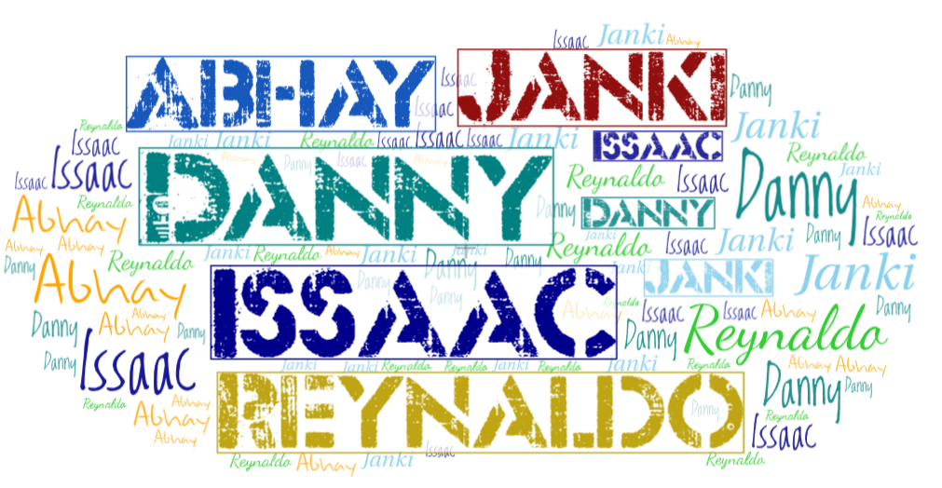
Tag Cloud
CECS 450:Data Visualization
Danny
Issac
Janki Patel
Abhay
Reynaldo

Slide 2
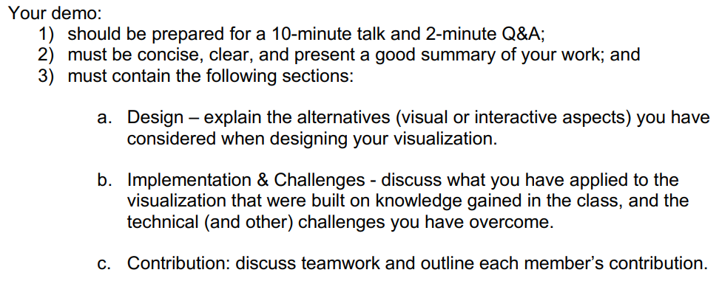
Requirements (Delete this slide when done)

Slide 3
Introduction/About
See speaker notes for details. Split up slides if you have to.
Notes:
Data Set: Lyrics of Nation Anthems (English translated)
Csv file input
Public domain license
Organized by:
Nation (country name)
YouTube URL
English transliteration of lyrics
Translated English lyrics
Flag image in base64 string format
Questions the word cloud would answer:
General
What makes a song a national anthem?
Do the lyrics of a national anthem have a significant meaning?
What do the lyrics tell us about the world in general?
What themes or concepts do nations commonly value according to their national anthem?
How do the lyrics relate to them?
Why do they appear again and again?
Specific Country
What can the lyrics tell us about a specific county?
What is a country’s national anthem about?
What themes or concepts does a specific country value according to their national anthem?
How do the lyrics relate to them?
Why do they appear again and again?
Target audience:
General
Someone who is going to make a new national anthem for an existing nation or new nation
Average person that wants to understand national values
For educational purposes, educational institutes may try to use this as evidence for common worldwide themes or values
Specific country
Someone who is going to make a new national anthem for the country
Average person that wants to understand national values if the country
For educational purposes, educational institutes may try to use this as evidence for the country’s themes or values

Slide 4
Design
See speaker notes for details. Split up slides if you have to.
Notes:
Official features that are part of the final product
Alternative features that were cut in the end
Just because you can, doesn’t mean you should
See 450 Project 1 Specs - Google Docs

Slide 5
Implementation
See speaker notes for details. Split up slides if you have to.
Notes:
From what we learn in class
Should be functional to get information quickly
Prioritize over style
Clarity (avoid misinterpretation)
Cut out features that aren’t very useful to the user
What makes a visualization interactable and how it would help the user
Never stray from the user’s goals for this visualization
Not overwhelming the user, but allow user the freedom to use interactive features to explore

Slide 6
Challenges
See speaker notes for details. Split up slides if you have to.
Notes:
Designing
Designing interesting and useful ideas and making sure that they were feasible to develop
Coding (technical) challenges

Slide 7
Contribution
See speaker notes for details. Split up slides if you have to.

Slide 8
Demo video?
See speaker notes for details. Split up slides if you have to.

Slide 9
References
See speaker notes for details. Split up slides if you have to.

